Slide 1
Masslist_Pro GUI
Readme
Zhensen 2026-01-26

Slide 2
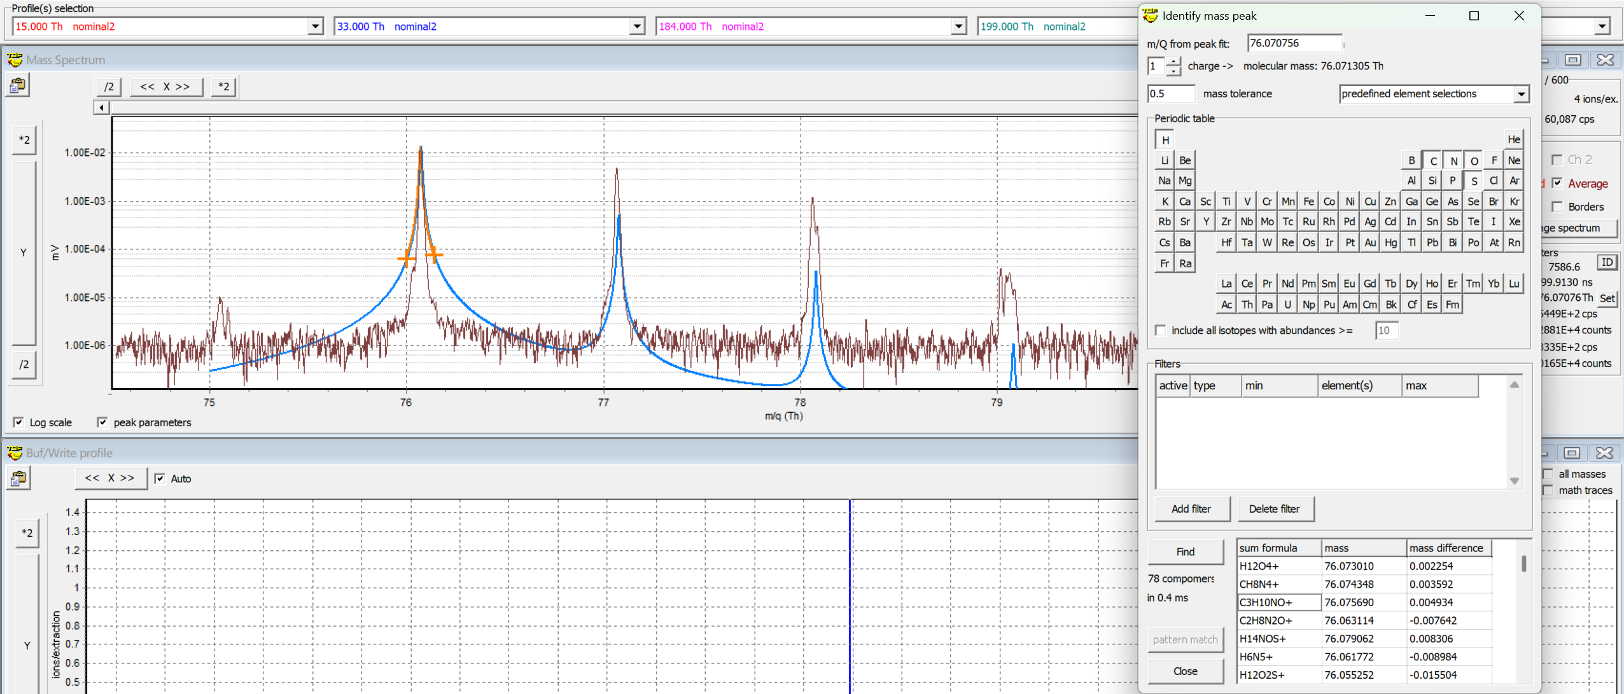
Assign formulas: considering the isotopic distribution

Slide 3
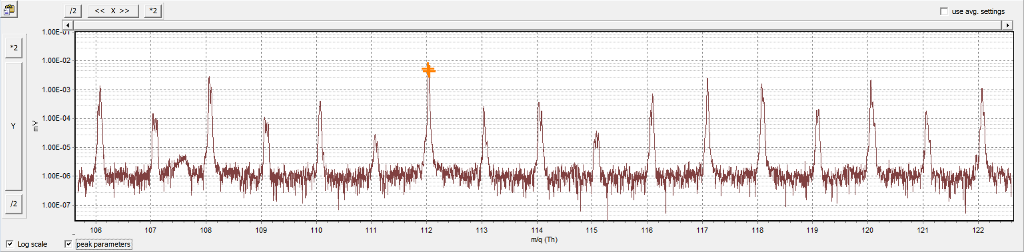
The pain of Data processing of mass spectrum
How could we find out what are measured compounds from mass spectrum data?
From experience (Best case but needs experience)
From literature and chemical dataset (good but time-consuming)
Could we automatically assign formulas to mass spectrum by an algorithm?

Slide 4
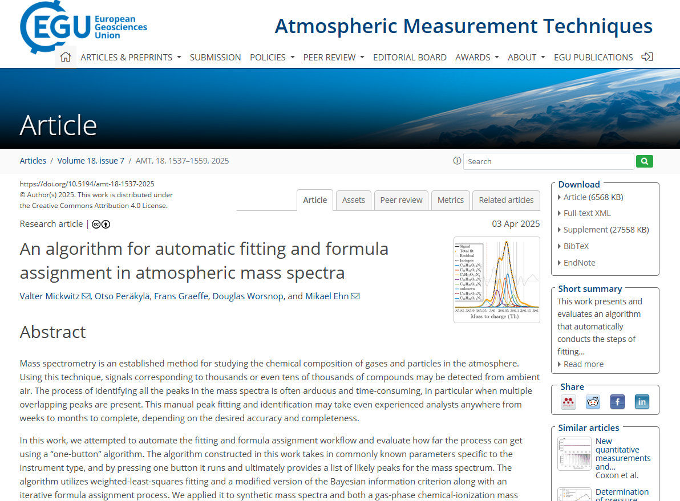
AMT - An algorithm for automatic fitting and formula assignment in atmospheric mass spectra

Slide 5
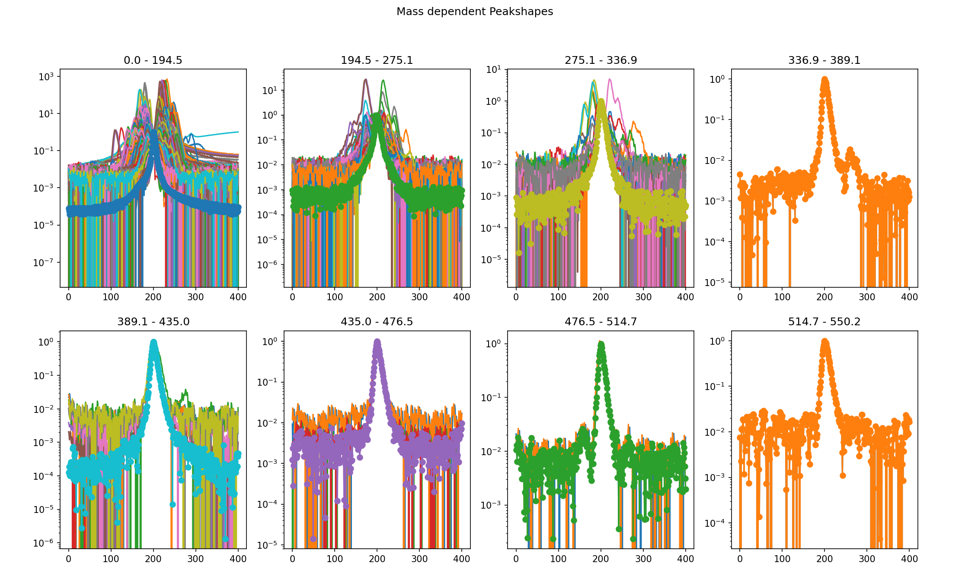
Dividing into different mass range and fit data based on the peak shape

Slide 6

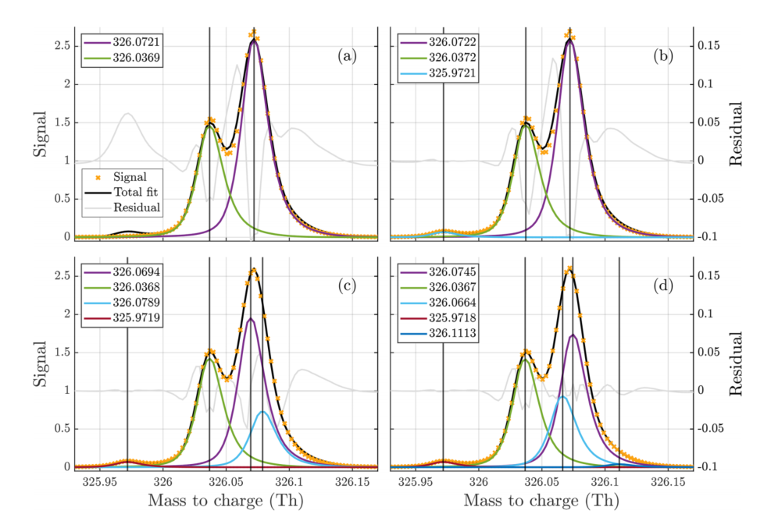
Fitting the function (from CLAUDE AI)
Mickwitz et al., AMT, 2025

Slide 7
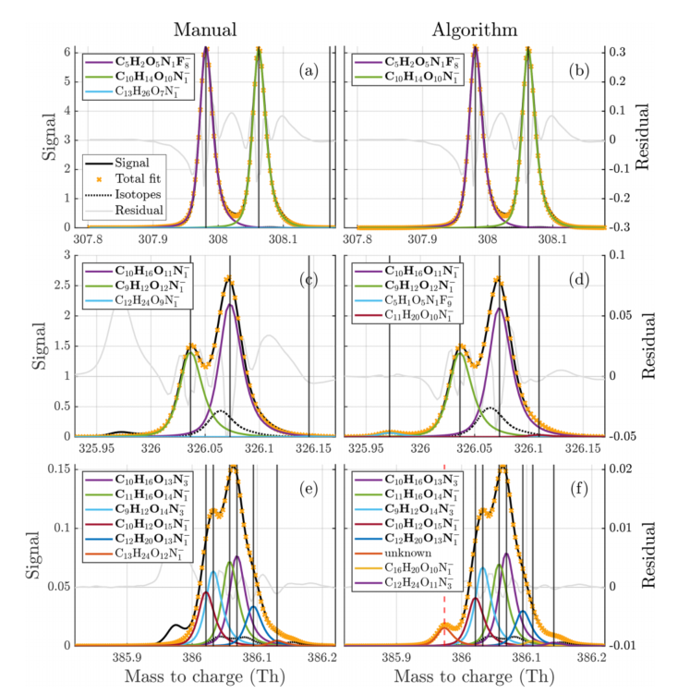
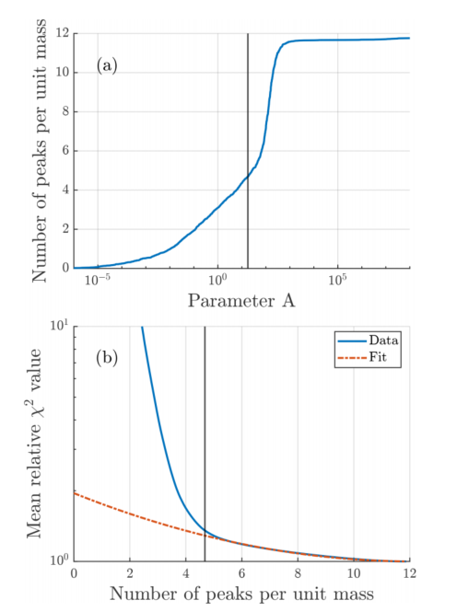


Determining number of peaks for fitting (in a small range)
Overall,
This score is less is better
This method is more Stratford and efficient
Mickwitz et al., AMT, 2025
Notes:
Least Squares Method， or more complicated approach takes longer computation

Slide 8
Rule to generating formulas or from known dataset (e.g., MCM, NIST, …)
Filter DBE < 0 case
1. Organic Species Rules (C ≥ 1)
Scope: Precursors, Oxidation Products (MVK, ISOPOOH, Pinonaldehyde, HOMs).
Constraints:
  0.3≤H/C≤2.5: Filters impossible structures (Note: Small molecules like methane/DMS may exceed this).
  0.0≤O/C≤3.0: Allows highly oxidized molecules (ELVOCs/HOMs).
Identification Examples:
  Isoprene (C5​H8​):
    Precursor: C5​H8​ [Pass].
    Oxidation: MVK (C4​H6​O) [Pass]. (Mickwitz/MVK)
    Oxidation: ISOPOOH (C5​H10​O3​) [Pass].
  α-Pinene (C10​H16​):
    Oxidation: Pinonaldehyde (C10​H16​O2​) [Pass].
    Oxidation: Pinonic Acid (C10​H16​O3​) [Pass].
  Trimethylbenzene (TMB, C9​H12​):
    Oxidation: C9​H12​O5​ (Auto-oxidation HOM) [Pass].
2. Inorganic Species Rules (C = 0)
Scope: Inorganic precursors & acids (SO2​,H2​SO4​,HNO3​).
Constraints:
  Heteroatom Check: Must contain S or N (Strictly filters pure water clusters Hx​Oy​).
  Safety Cap: H≤12. Ratio Checks: Skipped.
DMS Inorganic Products:
  SO2​: [Pass].
  Sulfuric Acid (H2​SO4​): [Pass].
3. Special Case: Small Sulfur Organics (DMS Loophole)
Issue: Small molecules often have high H/C ratios (>2.5).
DMS (C2​H6​S): H/C=3.0. Flagged by strict logic. → Must Load via MassList.
MSA (CH4​O3​S): H/C=4.0. Flagged. → Must Load via MassList.
MSIA (CH4​O2​S): H/C=4.0. Flagged. → Must Load via MassList.
Based onMickwitz et al., AMT, 2025

Slide 9
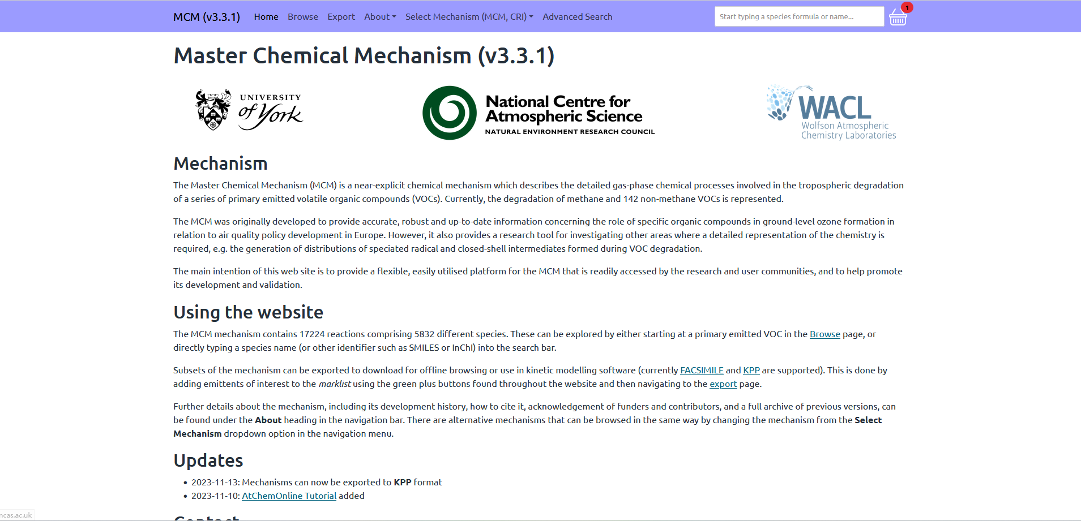
From known dataset (e.g., MCM, NIST, …)

Slide 10
Overview of the algorithm
Loading data
Peaking fitting based on known masslist
Peaking fitting based on unknown mass list
Creating Masslist
visualization
Cleaning overfitting peak

Slide 11
How to do it in Julia?

Slide 12
1. Package selection
using PkgPkg.add(["GLMakie", "NativeFileDialog", "DataFrames", "CSV", "XLSX", "HDF5", "LsqFit", "Combinatorics", "Interpolations", "ProgressMeter"])
2. Testing main function one by one, then merge and organize them
Details in the code script, will go to code tour!

Slide 13
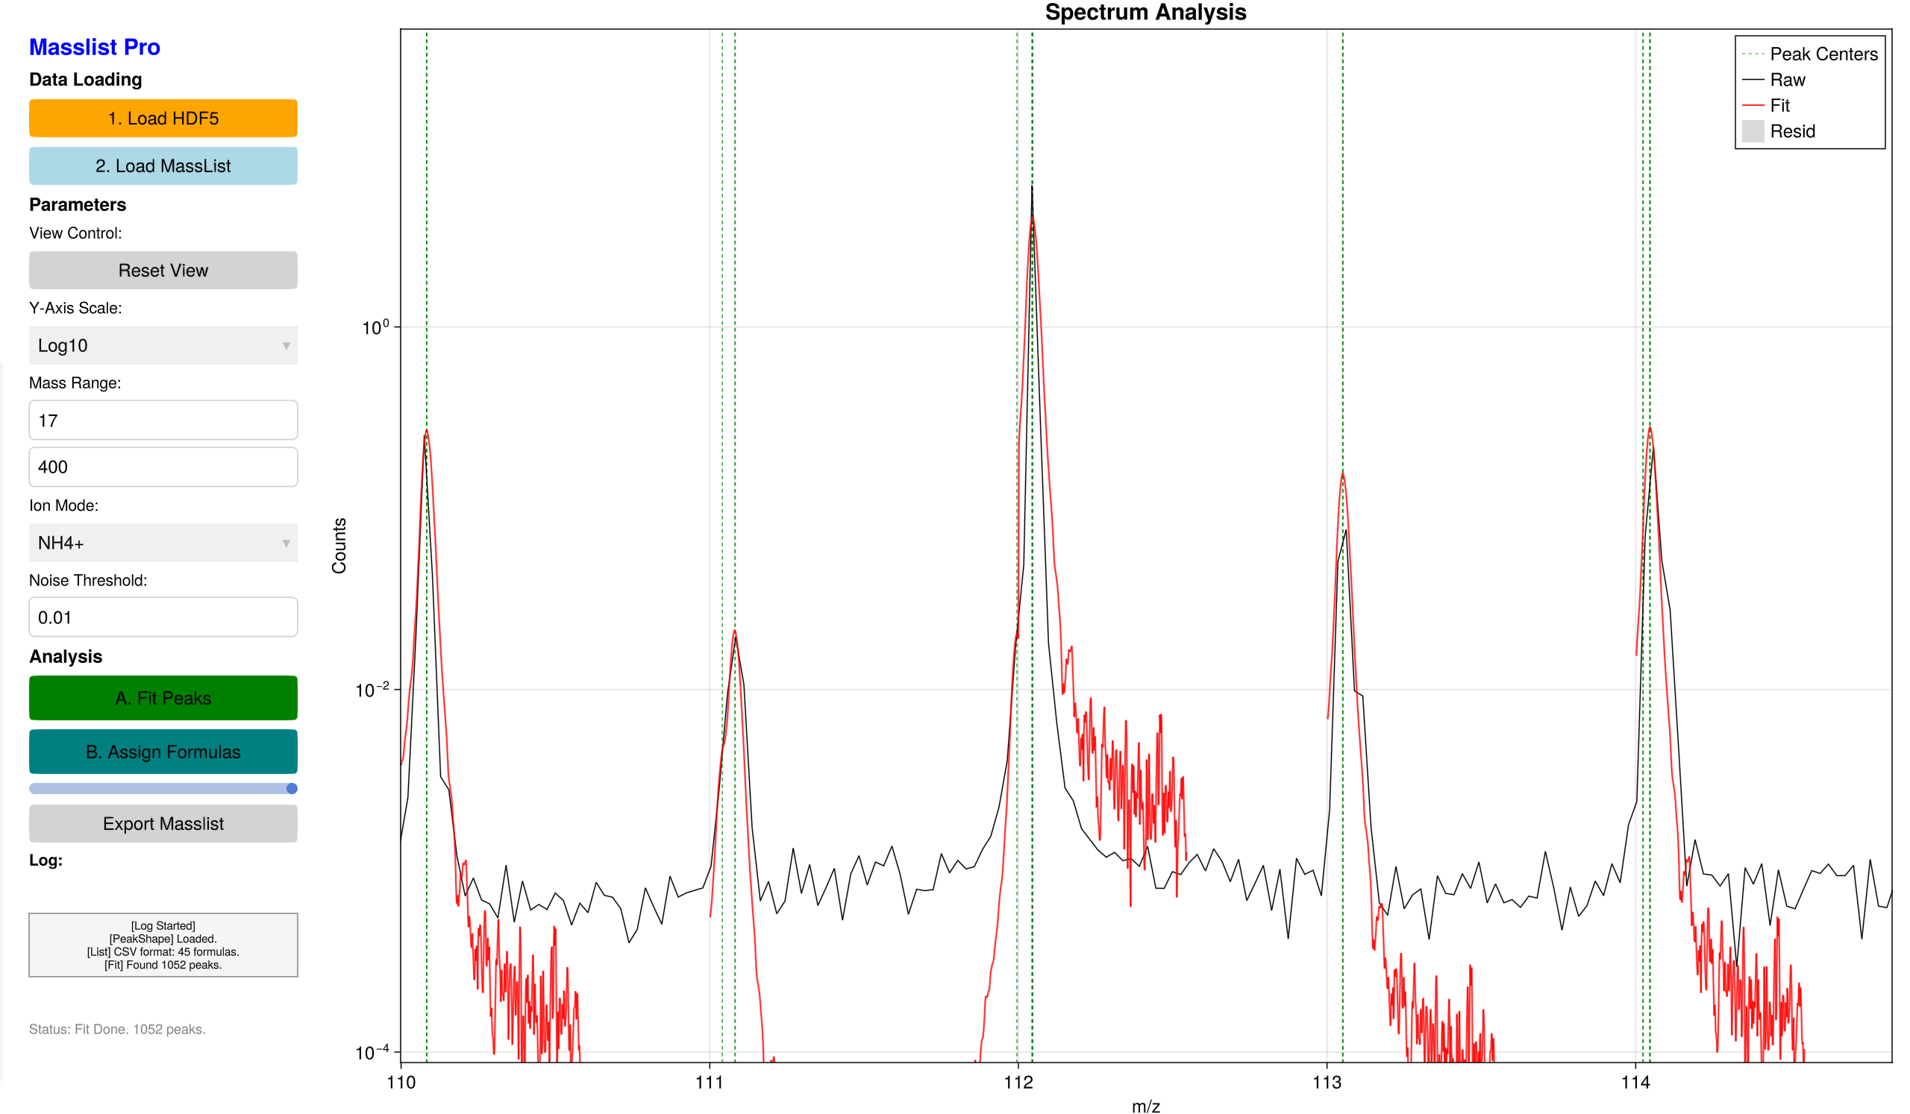

Slide 14
Thanks for listening!

